Slide 1
UHV-I Day 2 Recap of Day 1
…

Slide 2
UHV-I Session 1 Welcome and Introductions
The idea was to get to meet and know each other!
How did it go?

Slide 3
UHV-I Session 2 Exploring our Aspirations and Concerns
Planning for a fulfilling life by relating
academic success, career… expectations of family, peers…
to our basic aspiration…

Slide 4

How Would you Plan Your Life to Fulfil Your Basic Aspiration?
?
??
???
Present Effort
(1)
to Become
(2)
to Get/Do
(3)
to Be
(4) To be happy and prosperous
In continuity!
Plan with effort, steps at the base
Understand basic aspiration and plan the effort with that clarity
Basic Aspiration
The basic human aspiration is for the continuity of happiness and prosperity
We are making effort to realise our aspirations
(yet, there are problems, so we are trying to resolve them also)
Essential to fulfil our basic aspiration
Understand our basic aspiration (continuous happiness and prosperity)
Understand the program to fulfil our basic aspiration
Make focused effort for it (plan the steps with clarity of our basic aspiration…)
There are multiple steps, ways to fulfil our basic aspiration
If one way is closed, we can always pick another way
UHV is intended to help us with this

Slide 5
UHV-I Session 3 Basic Human Aspiration and its Fulfilment
Setting the correct priorities in life

Slide 6
Basic Human Aspiration and Program for its Fulfilment
PROGRAM:
Understanding Harmony
RIGHT UNDERSTANDING
(le>)
in the self
Understanding Harmony:
Harmony in Human Being
Harmony in Family
Harmony in Society
Harmony in Nature/Existence
VALUES
1
Education –
Understanding
2
3
RELATIONSHIP (laca/k)
with human being
PHYSICAL FACILITY
(lqfo/kk)
with rest of nature
Living in Harmony
all 4 levels:
Individual
Family
Society
Nature/Existence
SKILLS
Sanskar –
Living
Living in Harmony
with human being
Living in Harmony
with rest of nature
MUTUAL HAPPINESS
(mHk; lq[k)
MUTUAL PROSPERITY
(mHk; le`f))

Slide 7
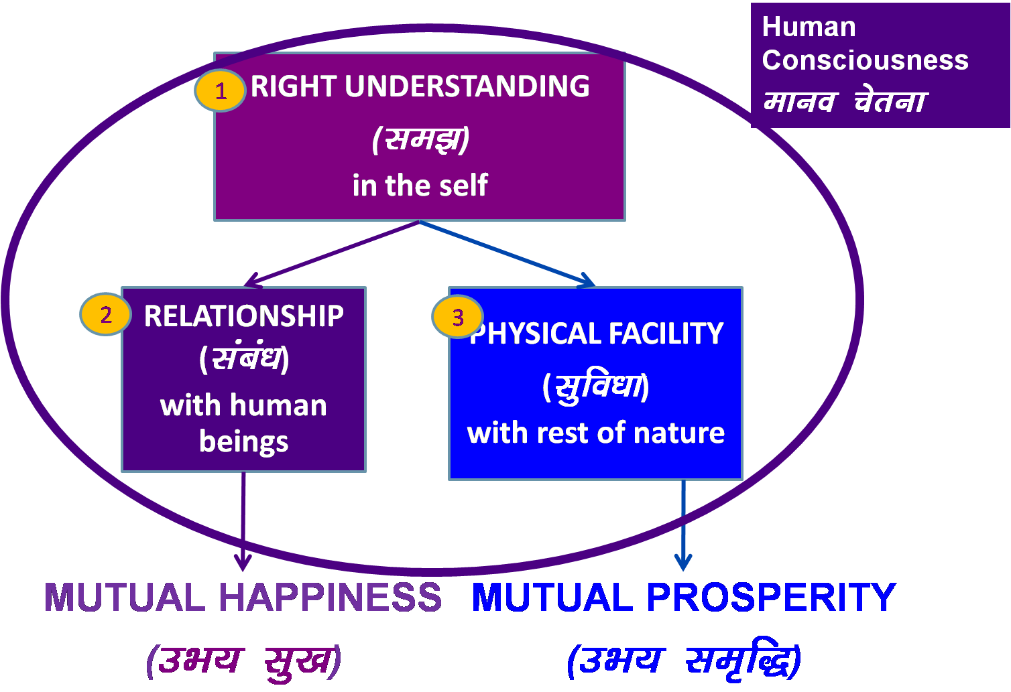
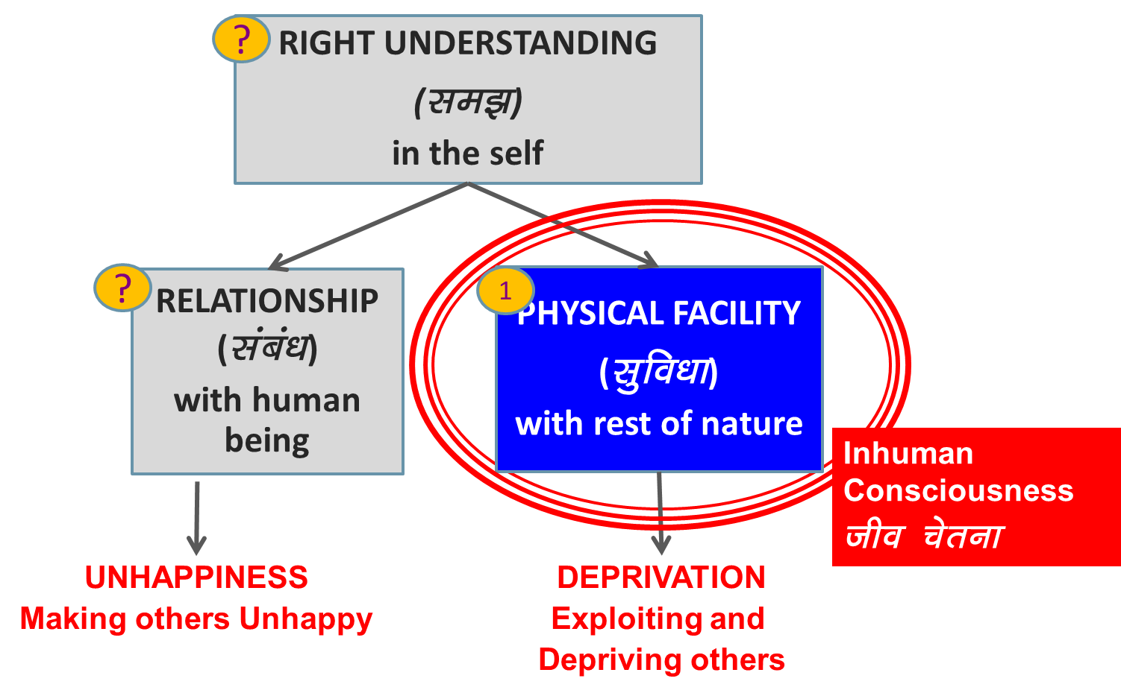
Holistic Development (विकास)
Is development just in increasing physical facility or development is ensuring of all 3?
Where do you want to be – on the left or on the right?
Is this transformation desirable?
Are we making effort for it?
Transformation& Progress
परिमार्जन-विकास
Do you need to make effort for it?
Should education help you to make this effort?

Slide 8
Your Sharing
Takeaways
Questions
Observations…

